Slide 1
PORTFOLIO PLANNING
INFT4000
Neo Lee, W0435748

Slide 2
Index
Description (Purpose)
Functionality
Colors
Storyboard
ERD
SAAD

Slide 3
Description

Slide 4
Pre-primary teachers need to purchase goods for the children in classes. After purchasing, a teacher must submit a reconciliation report to a director every month. This project will produce an automation for this requirements through the application by developing with electron.js.

Slide 5
Functionality

Slide 6
There are some functionality in this project
Report
Print
Purchase management
Append
Modify
Remove
Settings

Slide 7
Colors

Slide 8
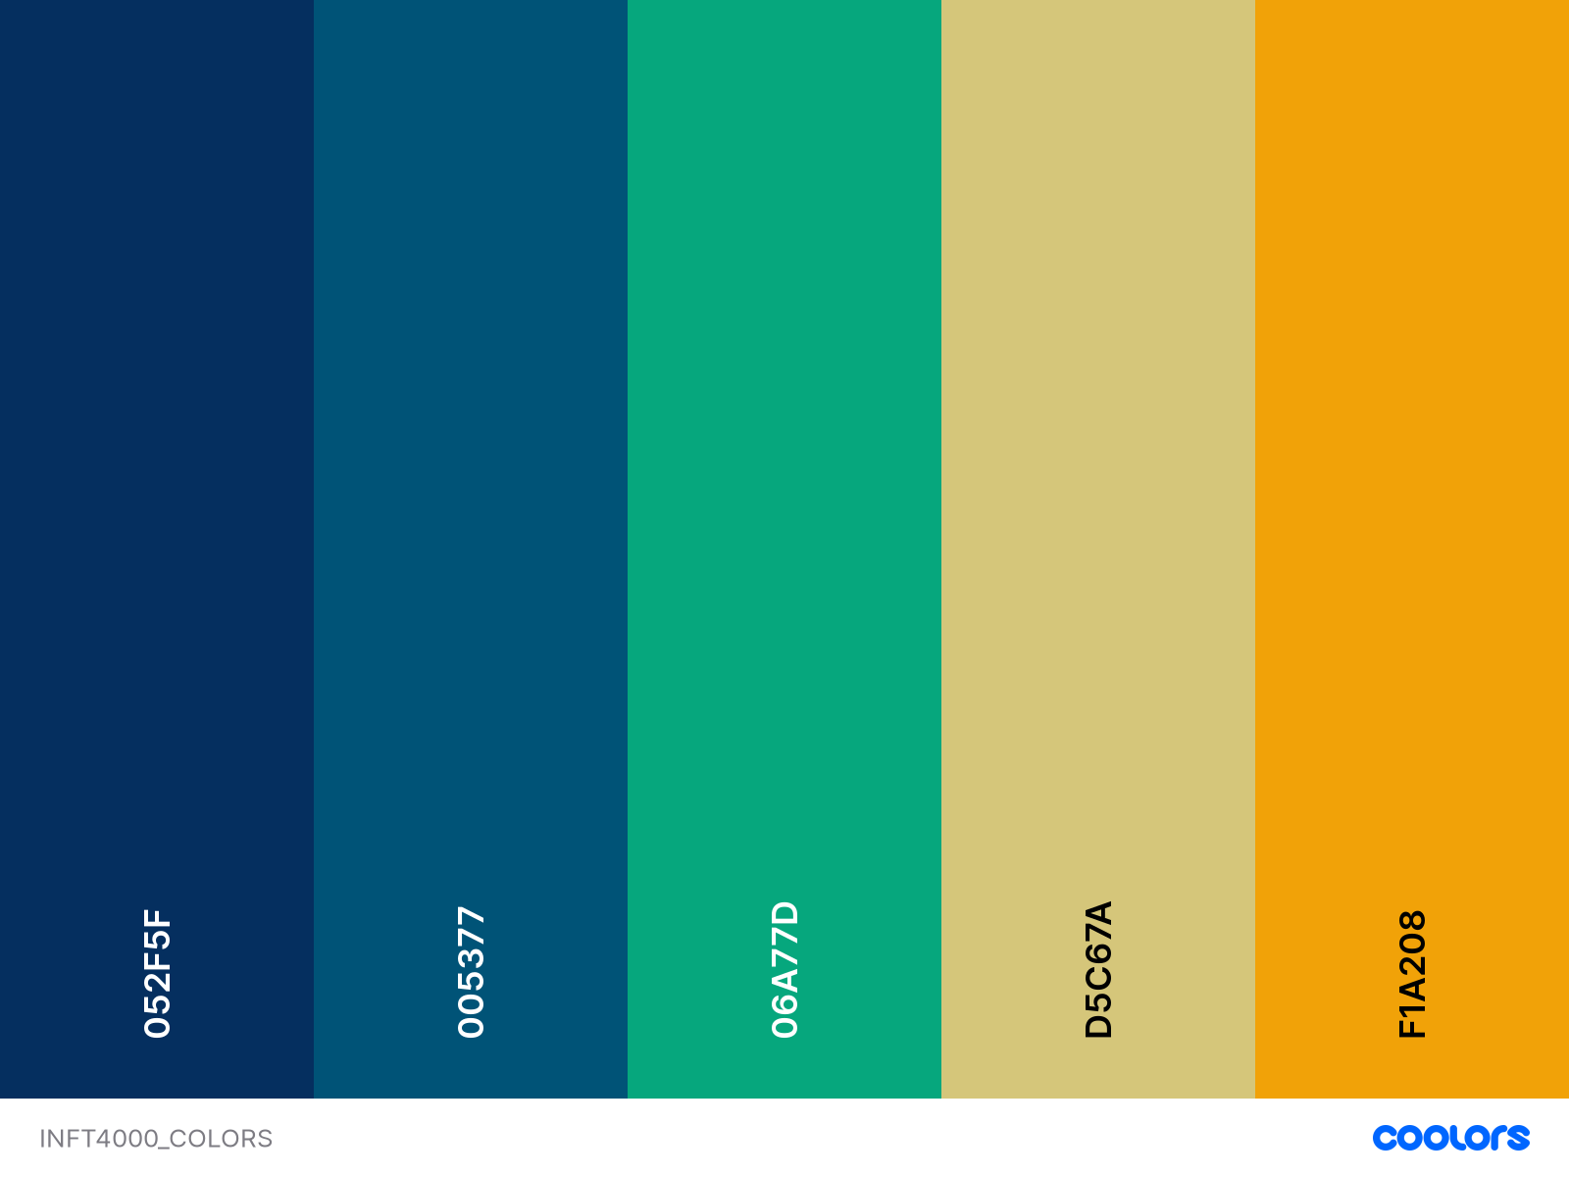
Buttons
In
Main Page
Add
/
Edit
Print
Report
Background
Delete

Slide 9
Storyboard

Slide 10
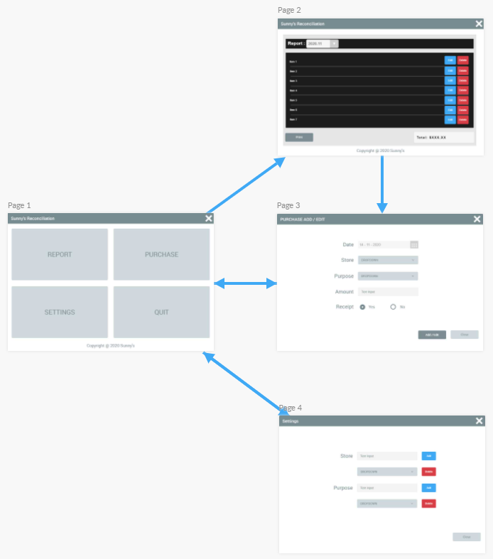
Pages Descriptions
Page1: Main Page
Page2: Report Page
- Display report
- Print report
- Edit or Delete items
Page3: Modify Page (Popup)
- Add items
- Edit items
Page4: Settings Page (Popup)
- Add/Delete Stores
- Add/Delete Purposes

Slide 11
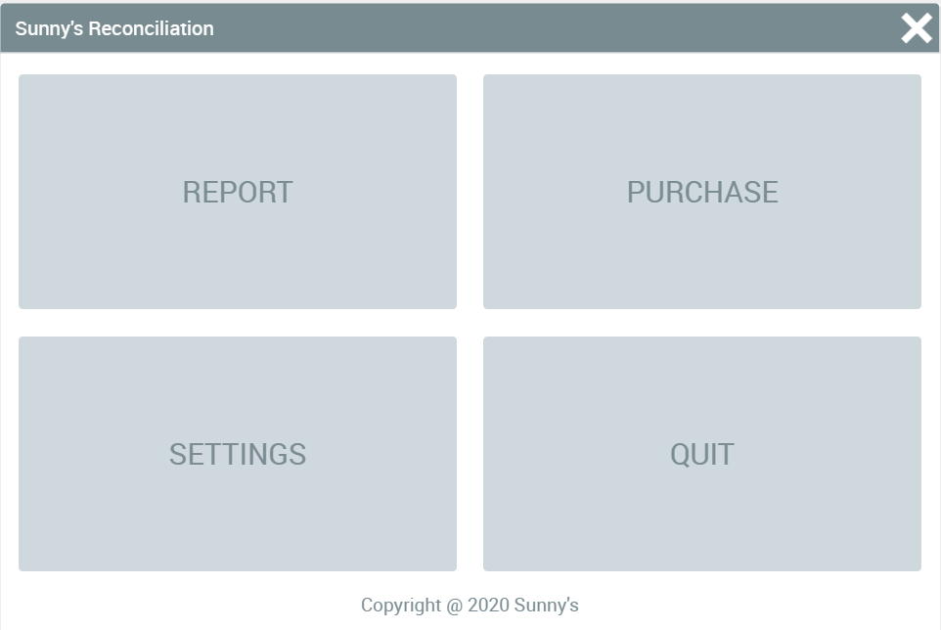
Main Page

Slide 12
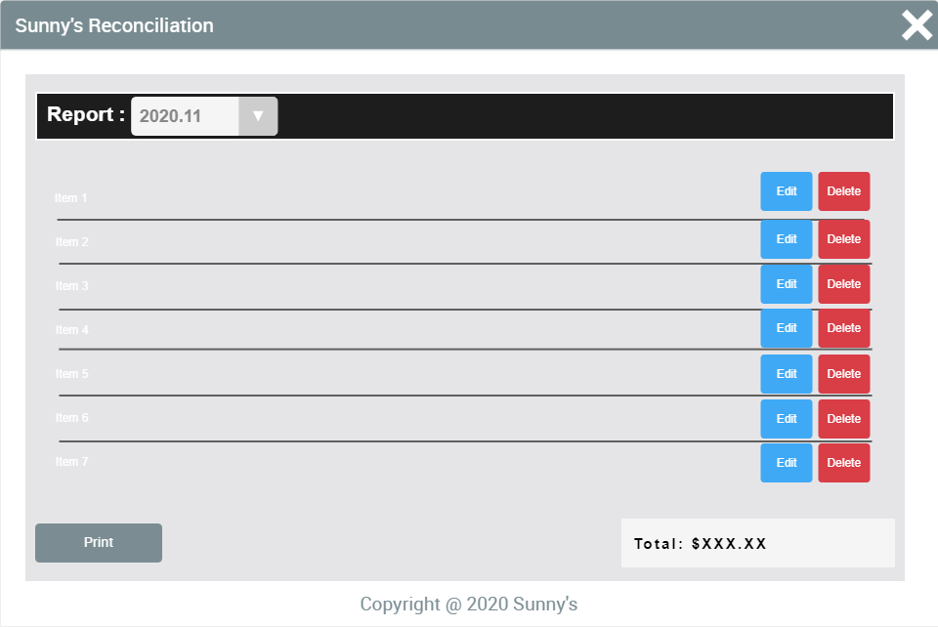
Report Page

Slide 13
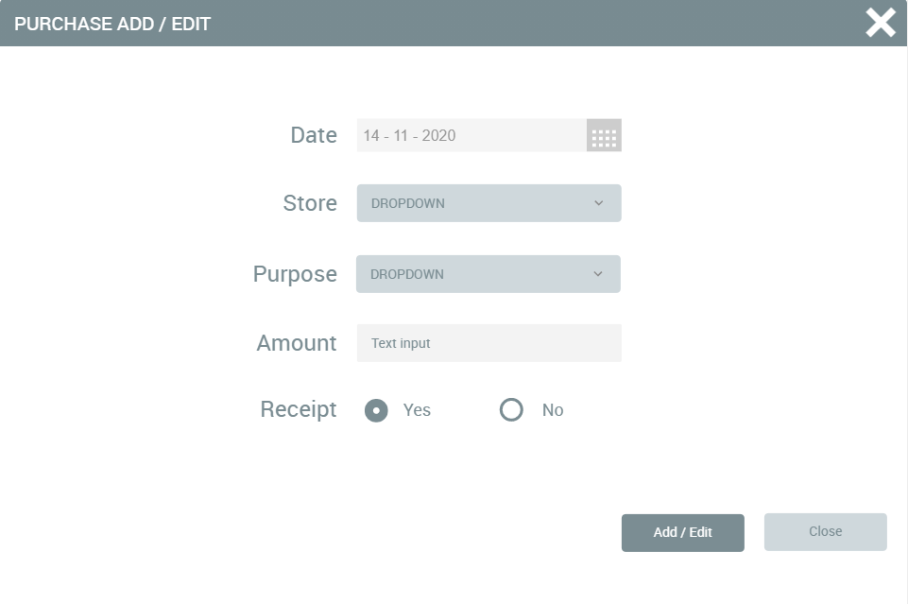
Modify Page

Slide 14
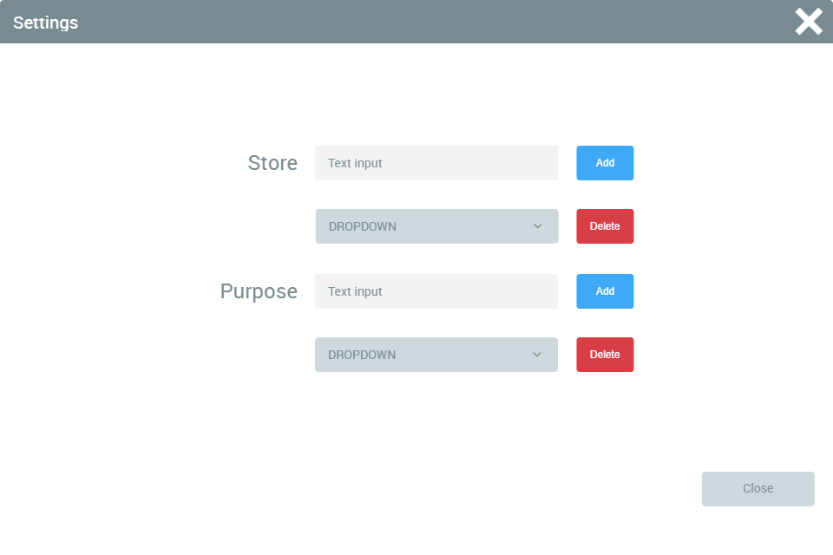
Settings Page

Slide 15
ERD

Slide 16
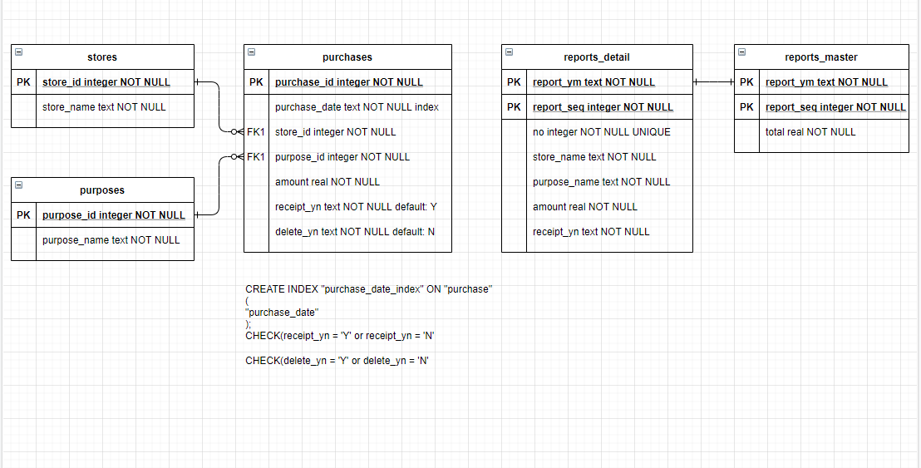

Slide 17
SAAD

Slide 18
It is made the word document

